Slide 1
Superbubble Driven Outflows in Cosmological Galaxy Evolution
Ben Keller (McMaster University)
James Wadsley, Hugh Couchman
CASCA 2015
Paper: astro-ph: 1505.06268
Keller, Wadsley & Couchman 2015
Background Image: Gas column density of IGM around a simulated
L* galaxy (image is ~10R_{vir} across). The dense central object is where the galaxy resides.

Slide 2
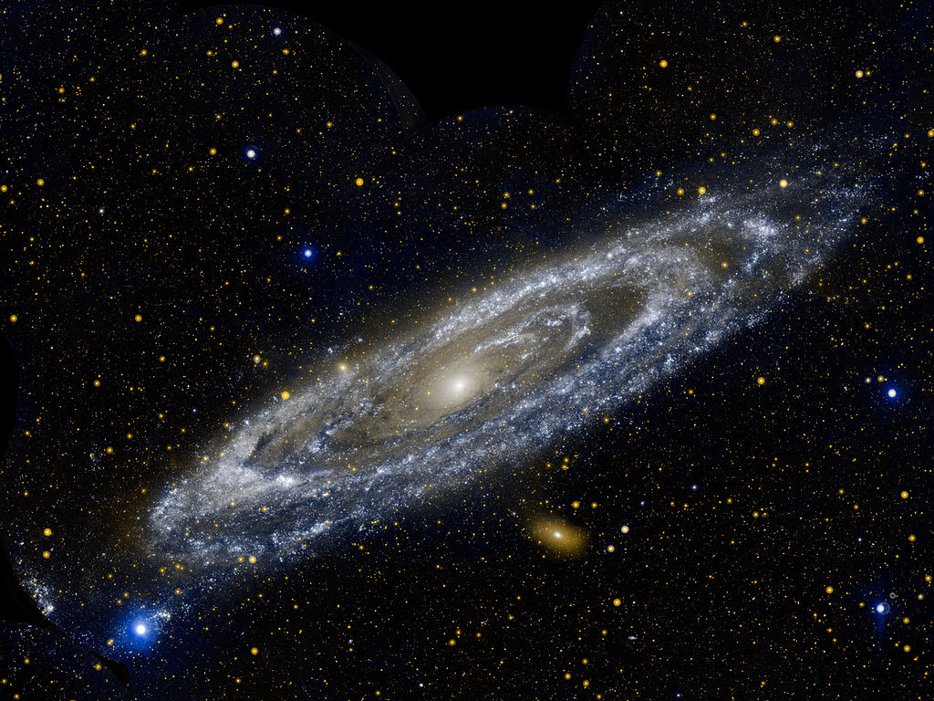
L* Galaxies: Star formation Engines
Most efficient star formers
Stellar Mass/Halo Mass 3-5%, lowest M/L ratio
Common! (We live in one)
Disk Dominated
Young Stellar Population
Halo Mass ~10¹² M_{ʘ}
M31 Image: GALEX NASA

Slide 3
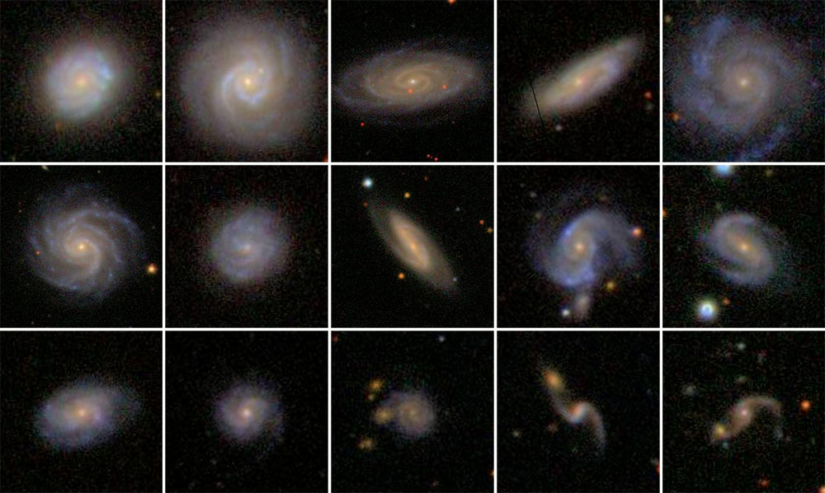
Small Bulges!
Most efficient starformers (highest M/L ratio)
Still inefficient in general, SFE ~1% today
Common! (We live in one)
Stellar Mass Fraction ~3-5%
Halo Mass ~10¹² M_{sun}
Image: SDSS/GalaxyZoo
M31 Image: GALEX NASA

Slide 4
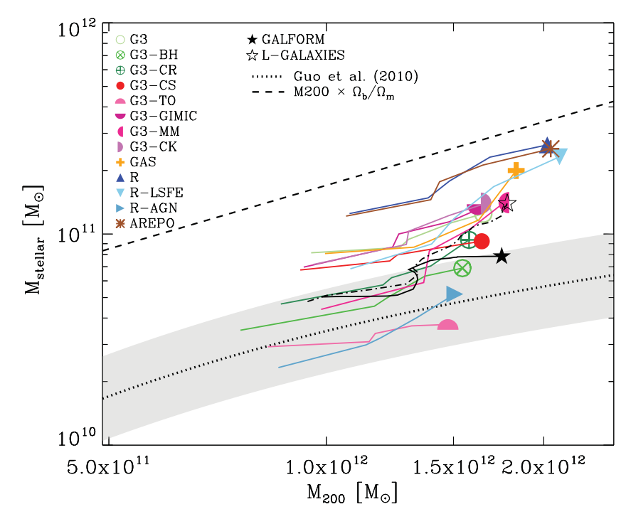
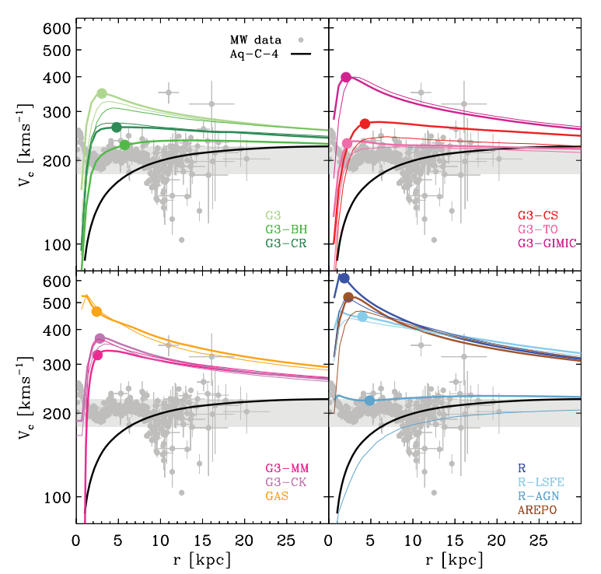
Tension between Theory & Observations
Aquila comparison (Scannapieco+2012)
Compared feedback models & simulation codes on same cosmological initial conditions
Most produced too many stars, too large bulge/disk ratios
None had both reasonable stellar mass fraction and small bulge.
Missing feature: Baryon expulsion!

Slide 5
Tension between Theory & Observations
Too Many Stars!
Aquila comparison (Scannapieco+2012)
Compared feedback models & simulation codes on same cosmological initial conditions
Most produced too many stars, too large bulge/disk ratios
None had both reasonable stellar mass fraction and small bulge.
Massive Bulge = Peaked Rotation Curves
Missing feature: Baryon expulsion!

Slide 6
How Galaxies Get Gas
Gas accreted and removed over galaxy's history
Cold flows dominate early (Woods+ 2014)
Fountains fuel low z star formation (Marasco+ 2012)
But: What powers outflows?
Galactic Wind
Hot
Accretion
Galactic
Fountain
Cold
Flows

Slide 7
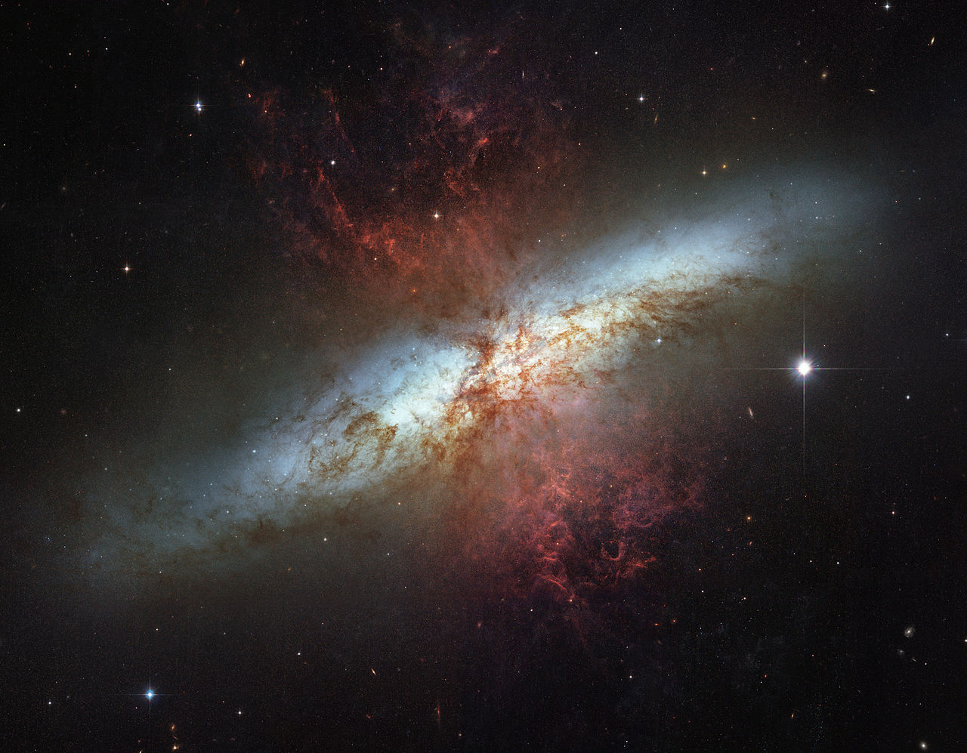
Galactic Outflows
Observational evidence abounds
UV absorption (Wiener+ 2009)
Hα emission lines (Heckman+ 1987)
Supernova powered superbubbles may power them (Larson 1974)
M82 Image: HST NASA/ESA

Slide 8
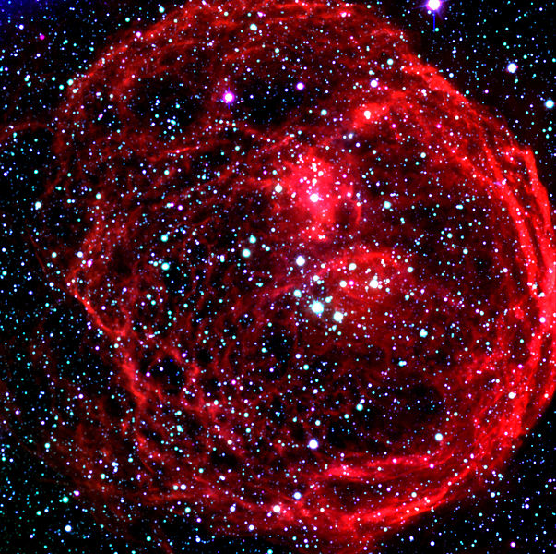
Superbubble features
Natural unit of feedback is a superbubble combining feedback from 100+ massive stars
Classic model:
Stellar winds + supernovae shock and thermalize in bubble
Negligible Sedov-phase
Mechanical Luminosity L=10³⁴ erg/s/M_{ʘ}
Much more efficient than individual SN (e.g. Stinson 2006 Blastwave feedback model)
N70 Superbubble LMC Image: ESO
D 100 pc Age: 5 Myr v ~ 70 km/s
Driver: OB assoc. 1000+ stars
MacLow & McCray 1988, Weaver+ 1977, Silich+ 1996
Notes:
8

Slide 9
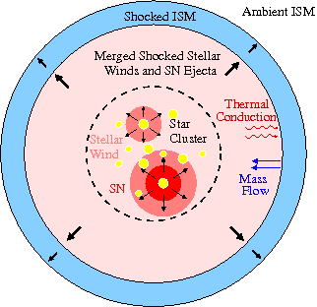
Superbubble Feedback
Key physical component is Thermal Conduction
Evaporates cold shell
Determines how much mass is heated by feedback (mass loading)
Keller+ 2014 developed model based on these physical processes
Low resolution sensitivity
Highly effective in isolated galaxies
MacLow & McCray 1988, Weaver+ 1977, Silich+ 1996

Slide 10
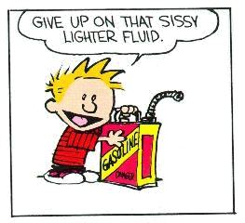
Gasoline
N-body Solver (Tree Method) and Smoothed Particle Hydrodynamics
Physics: Gravity, Hydrodynamics, Atomic Chemistry (Radiative Heating, Cooling), Radiative Transfer (Woods et al, in prep)
Subgrid Physics: Star Formation, Turbulent Diffusion
Wadsley+ 2004

Slide 11
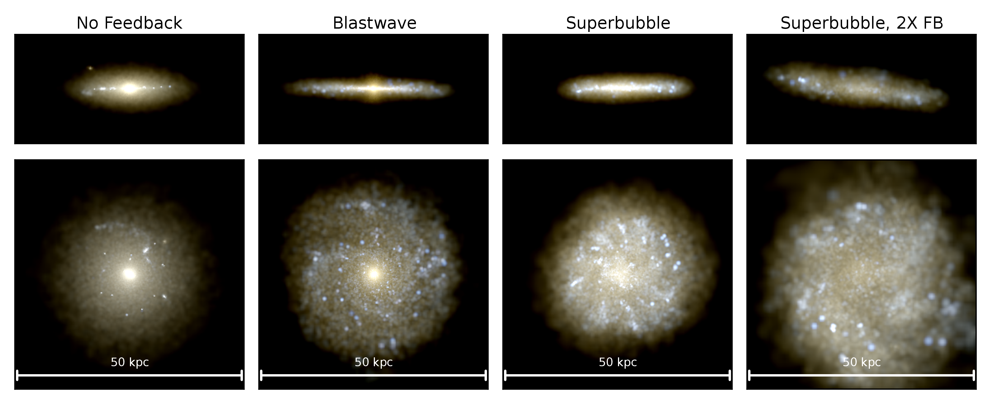
Simulations
4 test cases:
No Feedback
Blastwave (old Feedback)
Superbubble Feedback
E=10⁵¹erg/SN
Superbubble Feedback E x 2
Initial Conditions
8 x 10¹¹M_{sun} halo
Cosmological zoom-in
Last major merger at z=2.9

Slide 12
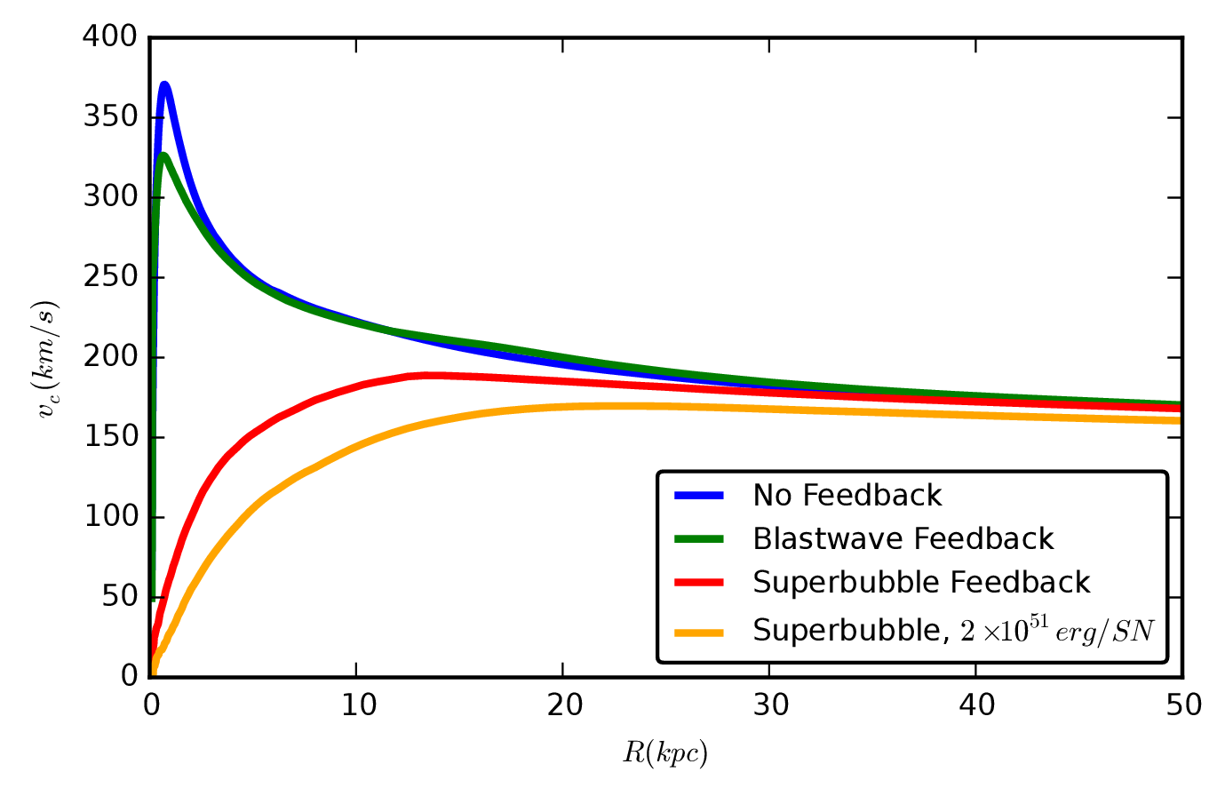
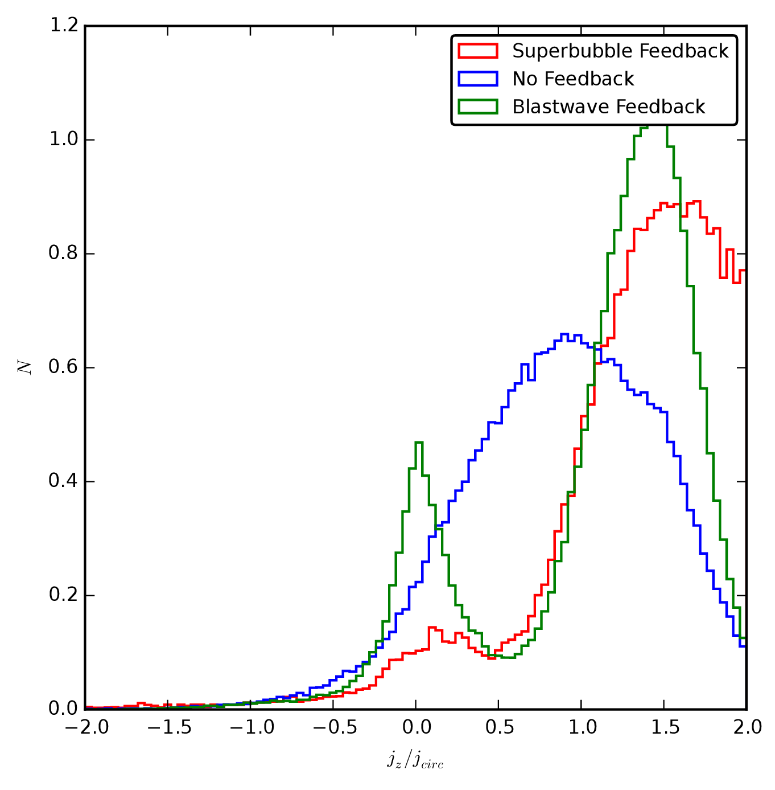
Rotation Curves
Disk
Bulge
Star Count
Flat rotation curves with SN only!
(c.f. Aquila,
Scannapieco+ 2012)
Angular Momentum

Slide 13
Rotation Curves
Star Count
Flat rotation curves with SN only!
(c.f. Aquila,
Scannapieco+ 2012)
Angular Momentum

Slide 14
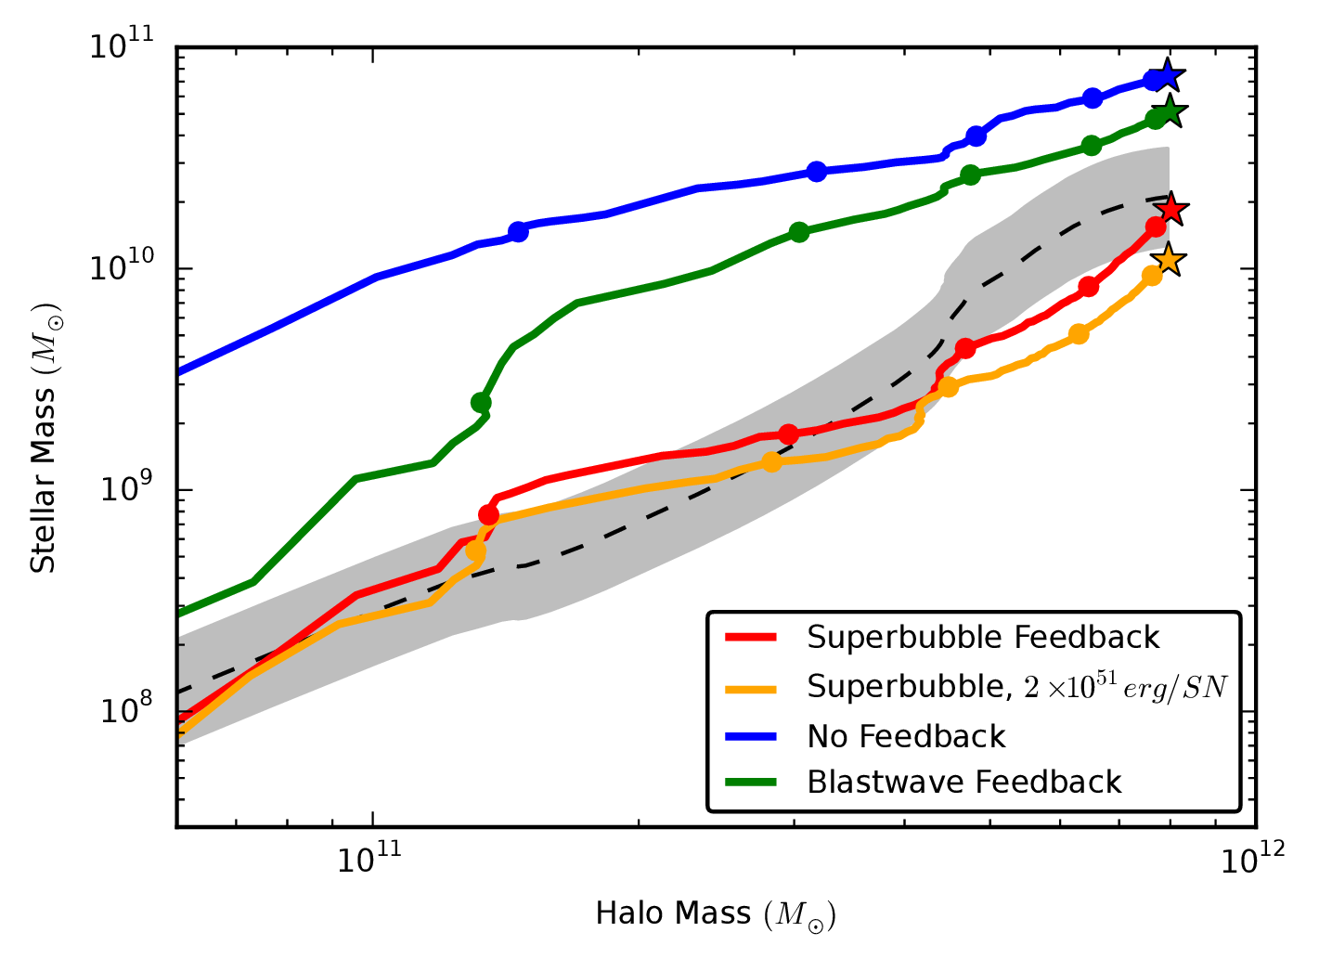
Stellar Mass Fraction
Abundance Matched Stellar Mass History: Behroozi+ 2013

Slide 15
Stellar Mass Fraction
Abundance Matched Stellar Mass History: Behroozi+ 2013

Slide 16
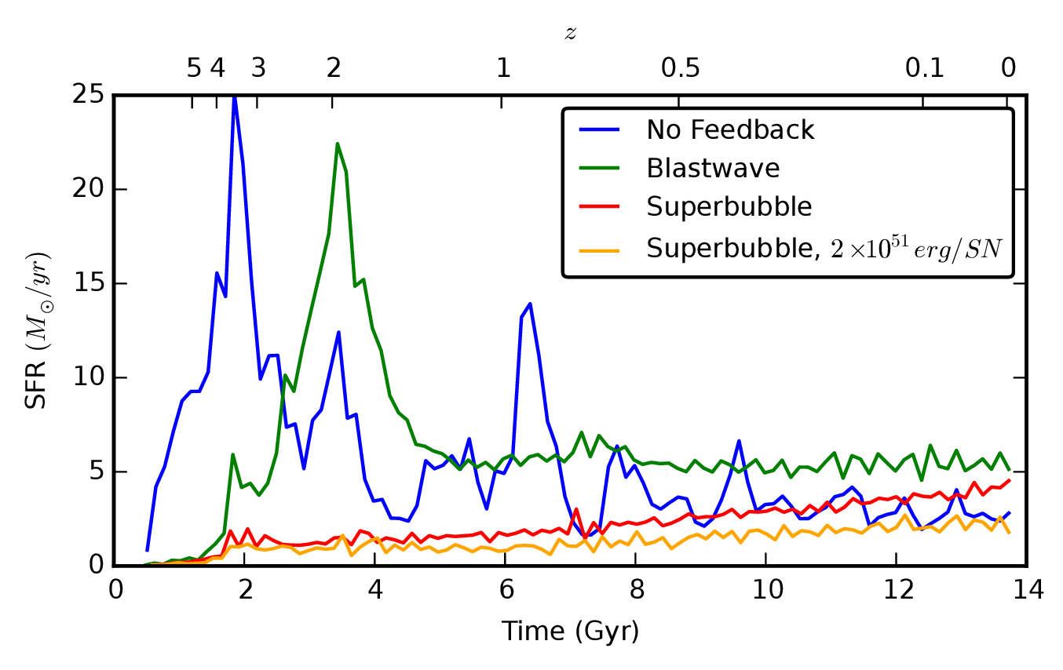
Star formation Rates
L* galaxies form ~90% of their stars after z=2.5
Older stars tend to live in bulge, halo
Could low angular momentum material be accreted early?

Slide 17
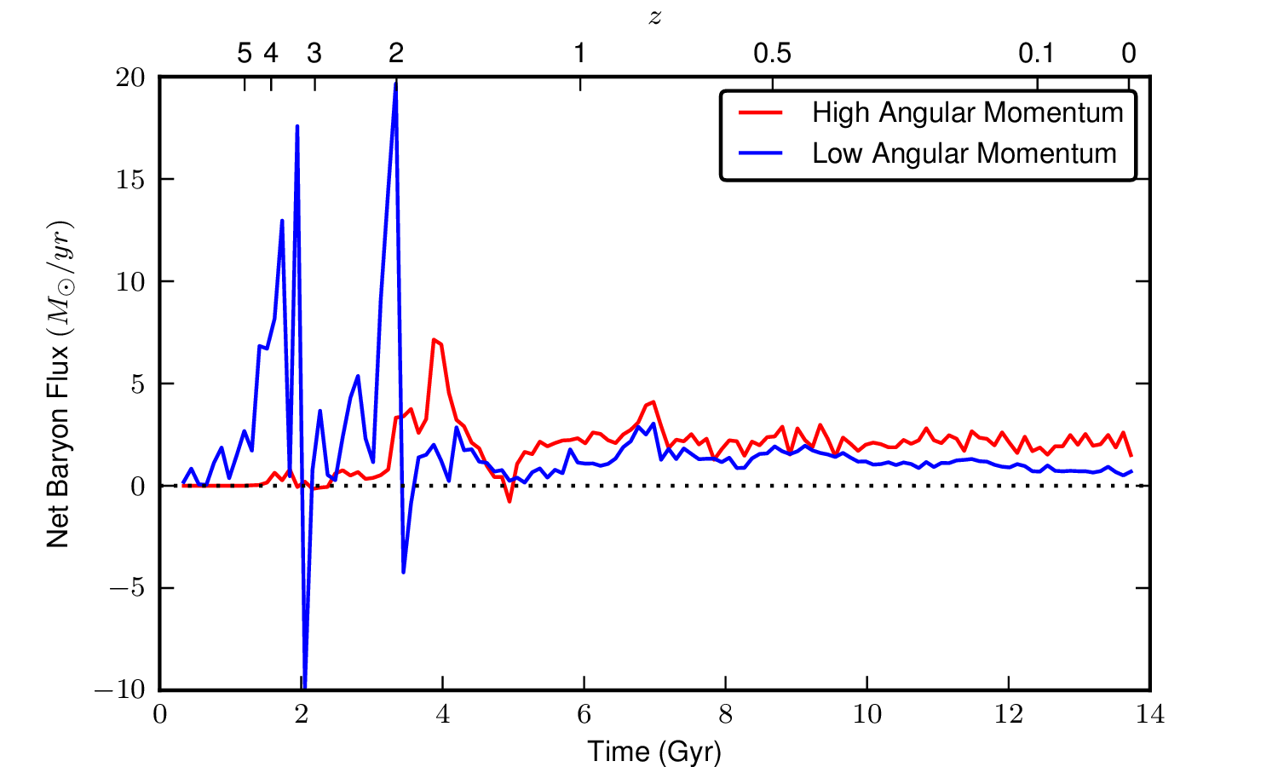
Accretion separated into high and low angular momentum gas

Slide 18
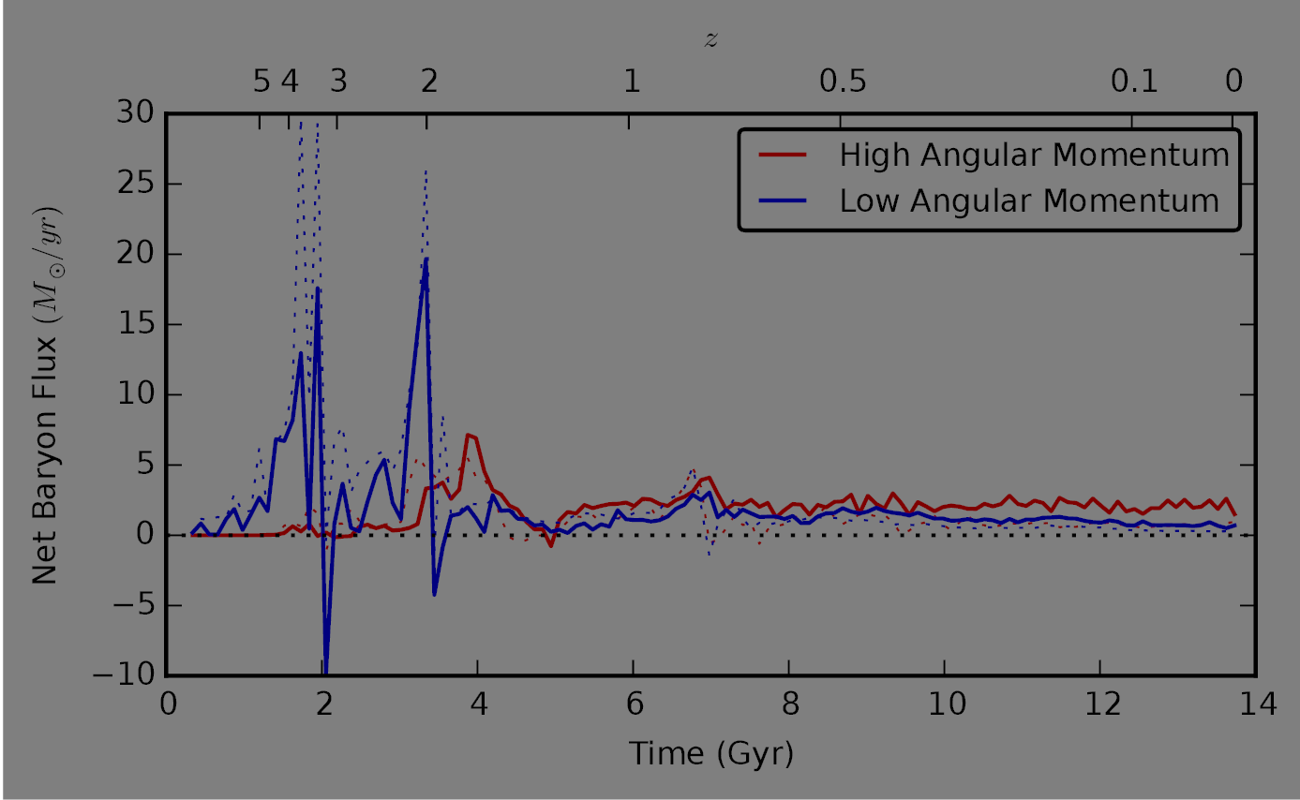
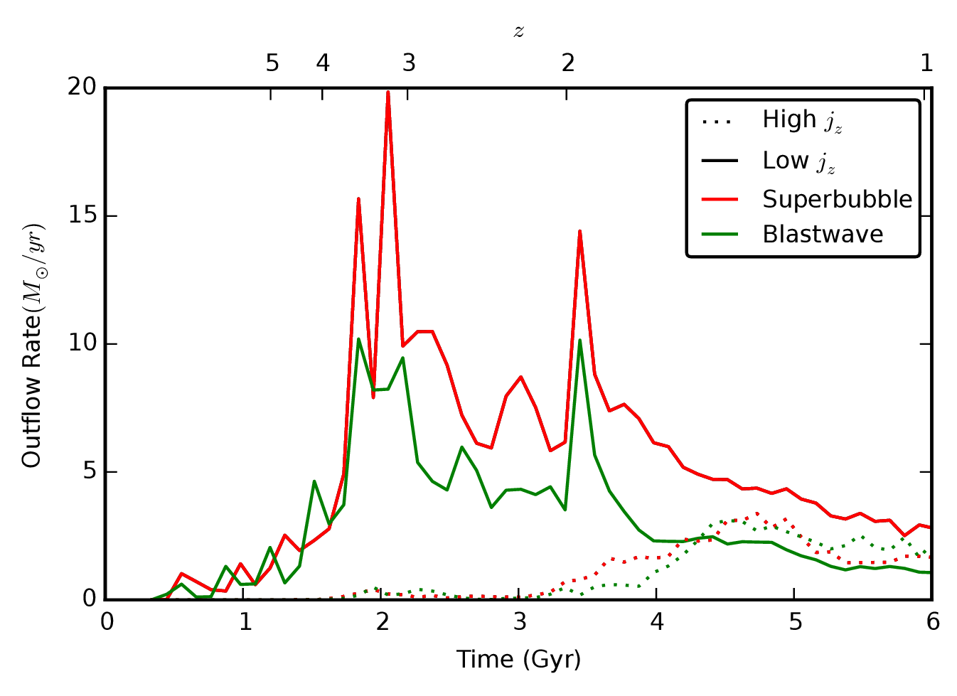
Accretion separated into high and low angular momentum gas

Slide 19
Accretion separated into high and low angular momentum gas
Disk-forming gas
Bulge-forming gas

Slide 20
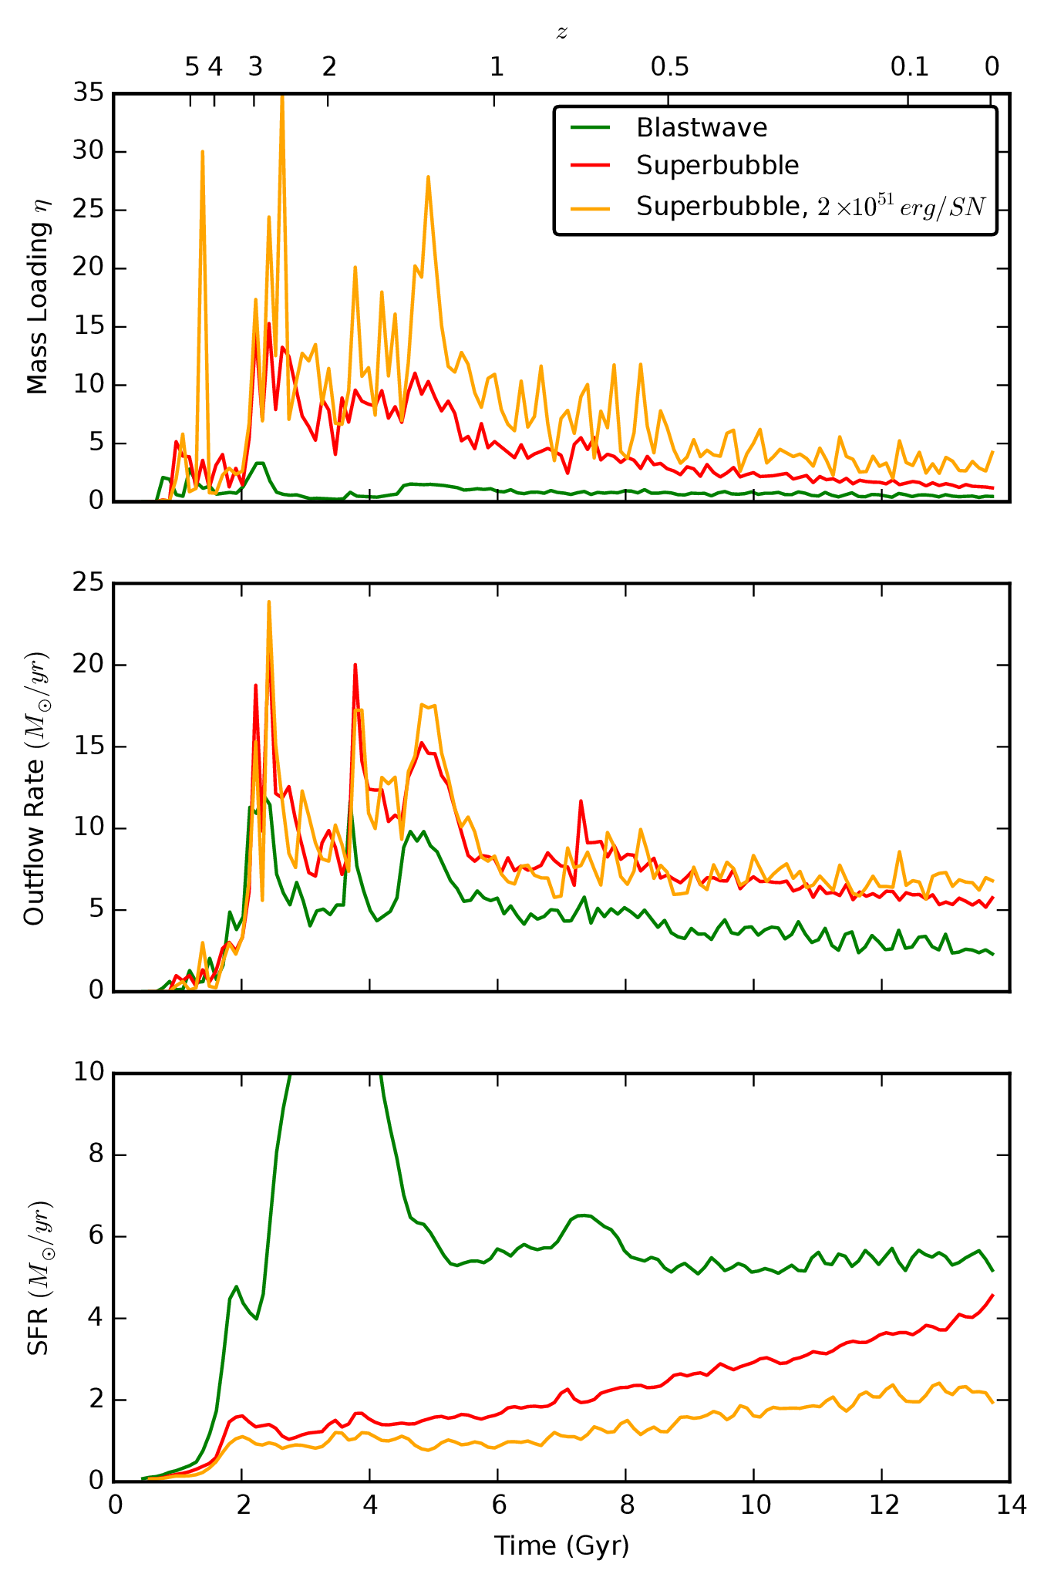
High Redshift Outflows Are Key
Potential well is shallow
High mass loadings: correct stellar mass fraction
Preferentially remove low angular momentum gas!

Slide 21
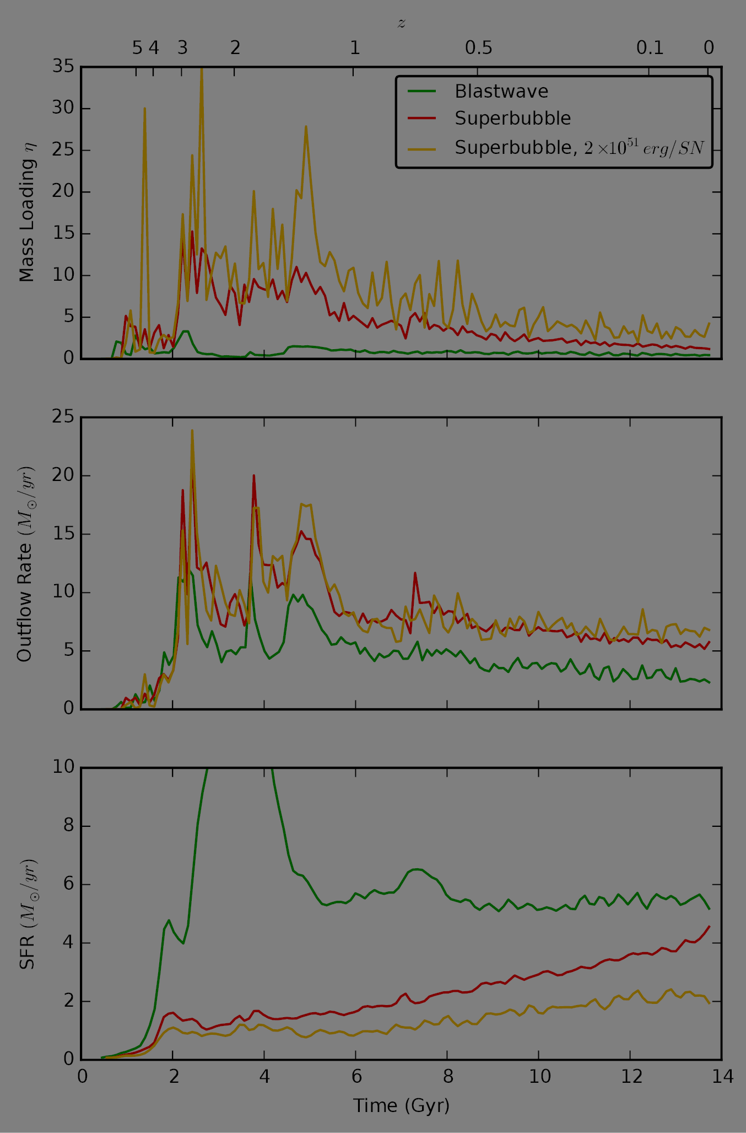
High Redshift Outflows Are Key
Potential well is shallow
High mass loadings: correct stellar mass fraction
Preferentially remove low angular momentum gas!

Slide 22
Conclusions
Galactic outflows can be driven by thermal supernovae feedback alone if physics of superbubbles is included in simulation
Strong outflows at high redshift remove gas that otherwise results in too many stars forming
These outflows preferentially remove low angular momentum gas, preventing the formation of a massive bulge
We can make a Milky Way ☺
Paper: astro-ph: 1505.06268

Slide 23
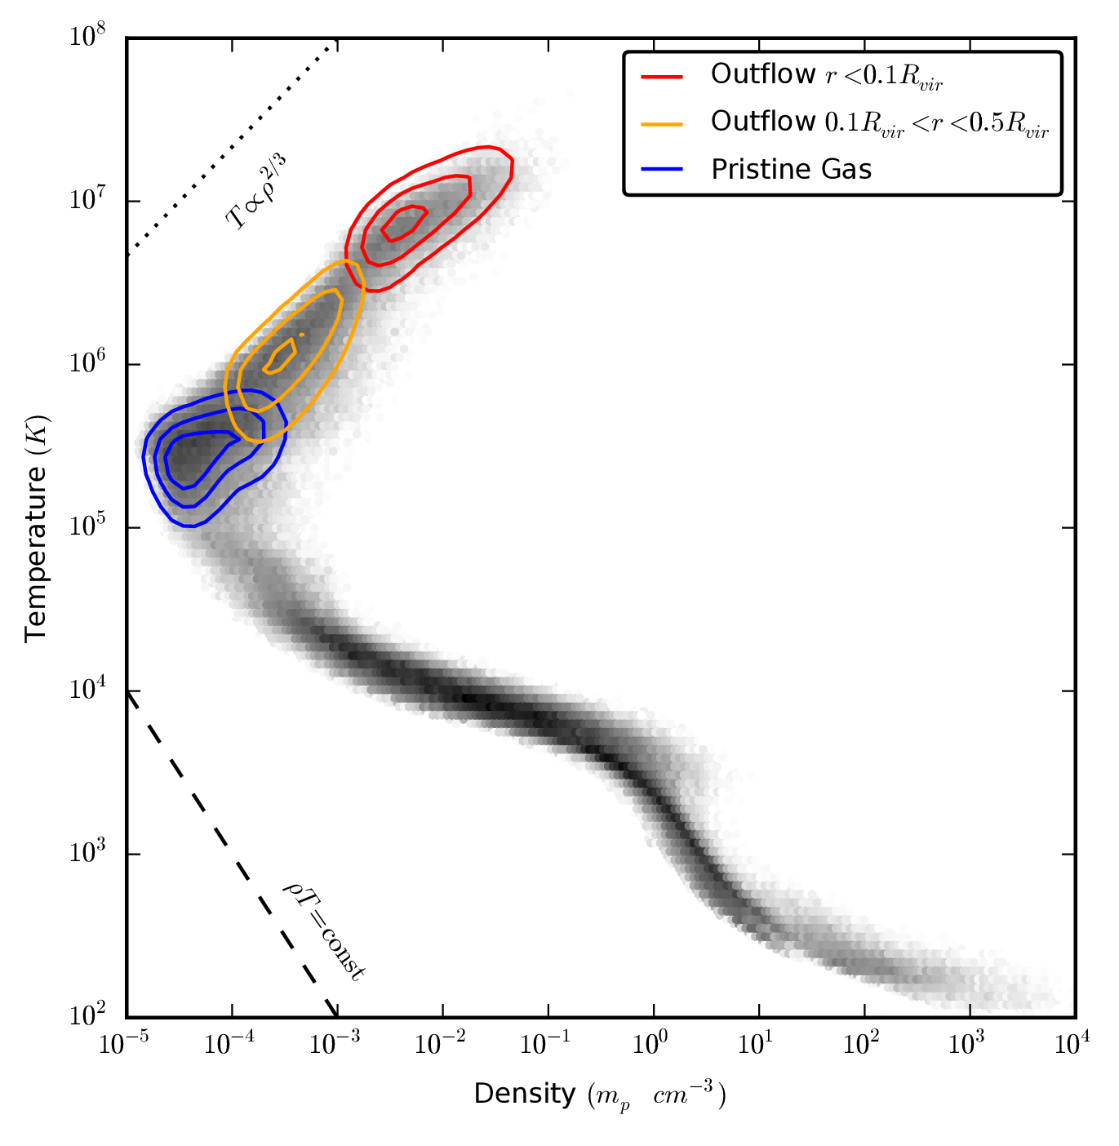
Lifecycle of Gas
Virialized halo gas cools to form disk ISM
Disk ISM cools, forming stars
SNII heats gas to form superbubbles
Superbubbles rise buoyantly out of disk, cooling adiabatically & mixing with pristine gas
4
3
1
2

Slide 24
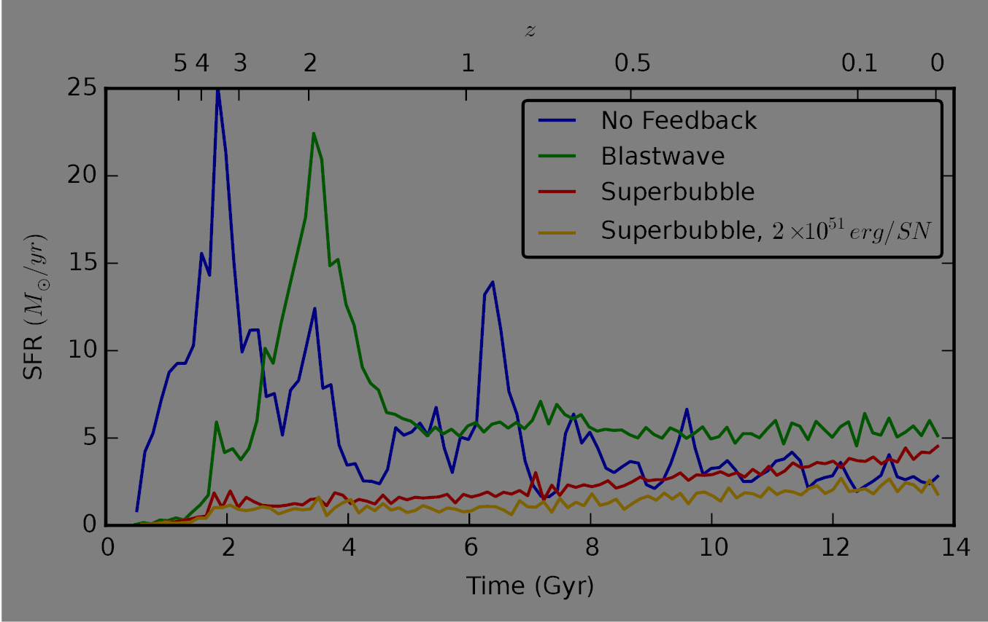
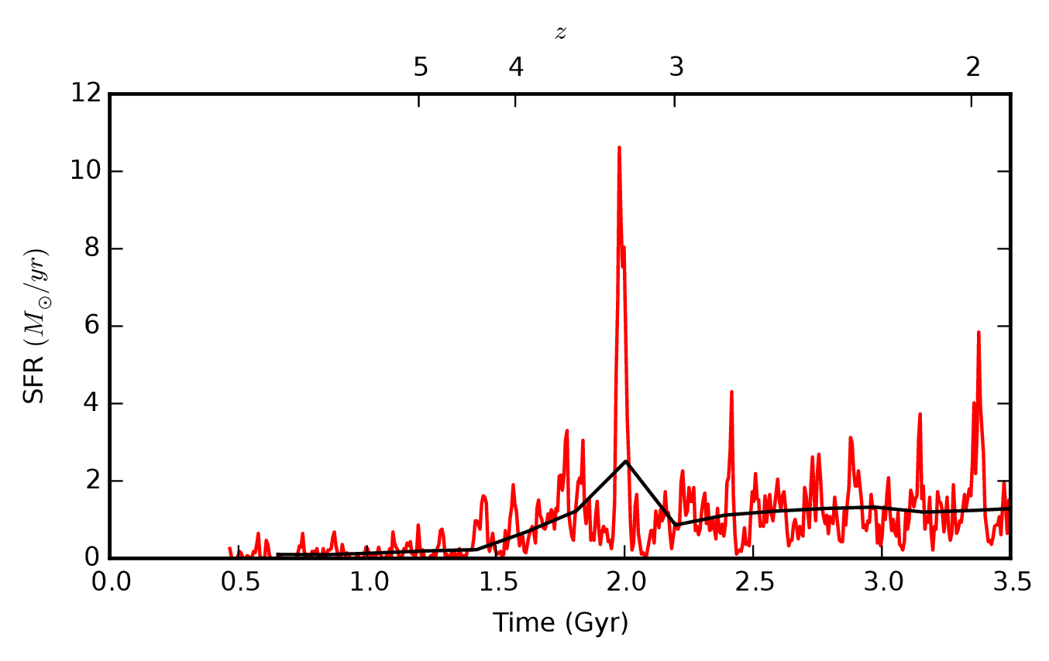
Bursty Star formation
Short timescale bursts help drive outflows

Slide 25
Stellar Feedback Budget
UV & Radiation pressure disrupt dense clouds
Denser gas (>10⁴ H/cc) dispersed, star formation cut off
SN_{II} and stellar winds
Steady 10³⁴ erg/s/M_{ʘ}
for ~ 40 Myr
Starburst ‘99 Erg per M_{ʘ}
Bolometric Luminosity
Winds
Energy Injection Rate (log10 erg/s/M_{ʘ})
Supernovae
Type II
UV
Time (years)
Notes:
Note: 3e34 upper limit

